Slide 1

Shop Management System
Distributed Database Management System Project

Slide 2

Supervised by
Submitted by
Fazle Rahat
Lecturer
Dept. of CSE
Bangladesh University of Business and Technology (BUBT)
Syeda Nowshin Ibnat (17183103020)
Mahmuda Begum(ID: 17183103030)
Nusrat Jahan Anka(ID: 17183103008)
Nawrin Zaman Prova(ID: 17183103044)
Intake - 39(1)
Dept. of CSE, BUBT

Slide 3
Table of Contents
Introduction
Objectives
Description of the system
Methodology
Diagram
Software Specification
How it looks
Future Works
Conclusion
Reference

Slide 4
Introduction
Shop management System project is all-in-one solution which will help manage the shop and save time by automating and simplifying every day’s operations.

Slide 5
Objectives
Automate the existing manual system.
Reduce time to manage the system of a shop.
Data/information can be stored for a longer period with easy access.

Slide 6
Description of the system
A shop management system will use to manage shops effectively. It is a desktop-based system to reduce manual work.
This system is for two different users.
A login option for the user, employee.

Slide 7

Methodology

Slide 8
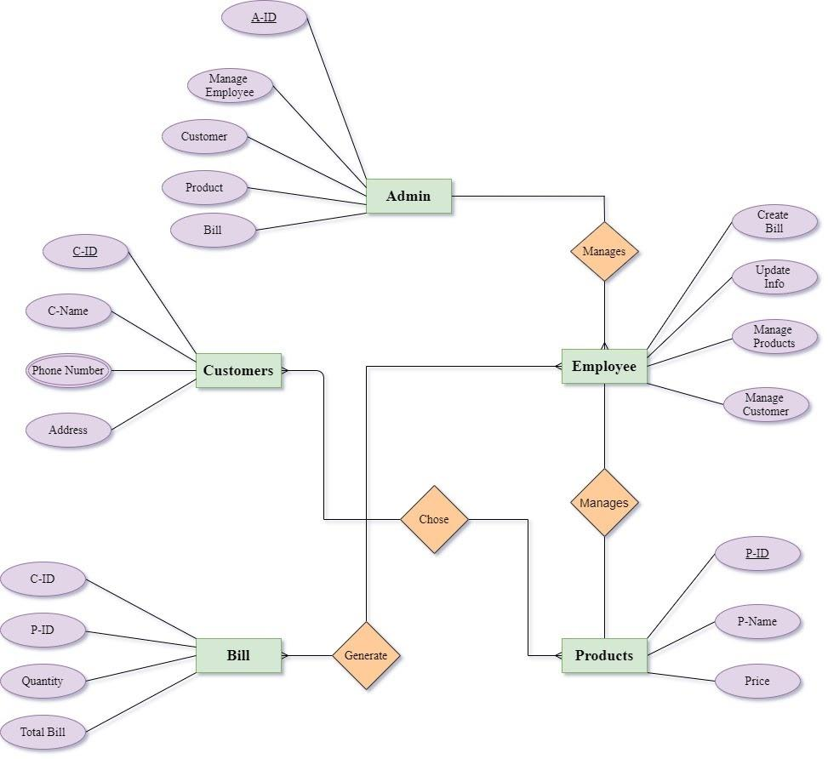
Diagram
Figure: ER-Diagram

Slide 9
Software Specification
Language: JAVA
Database: SQL
Database Server: Xampp
IDE: Netbeans, Notepad ++
Documentation tool: Google docs, slides.

Slide 10
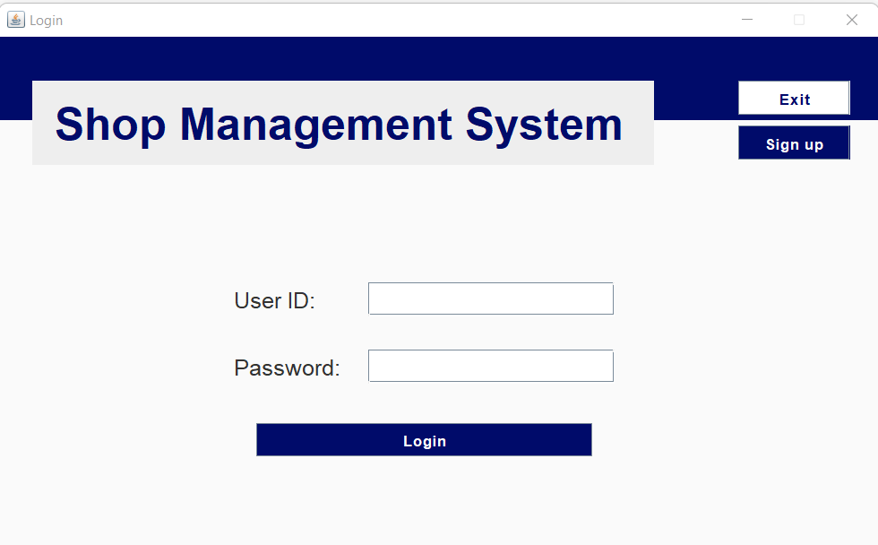
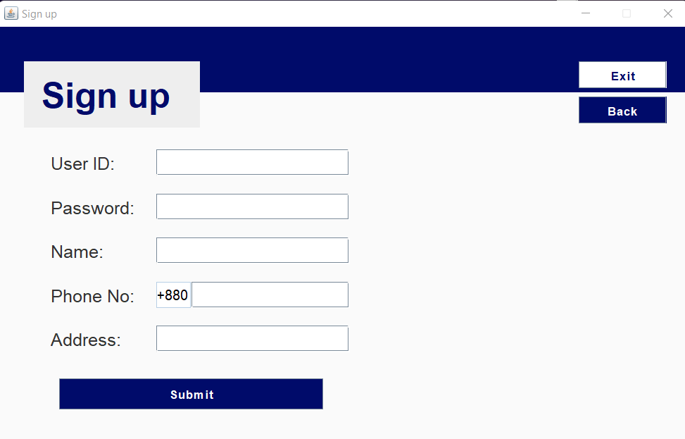
How it looks

Slide 11
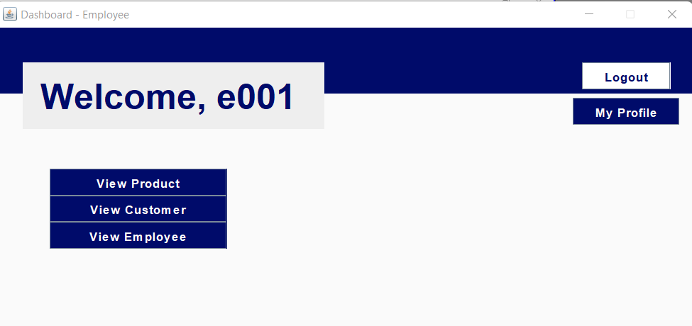
How it looks cont.

Slide 12
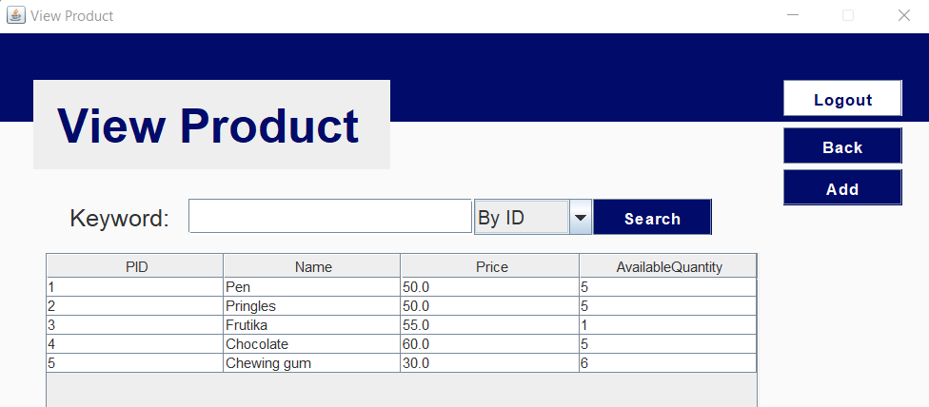
How it looks cont.

Slide 13
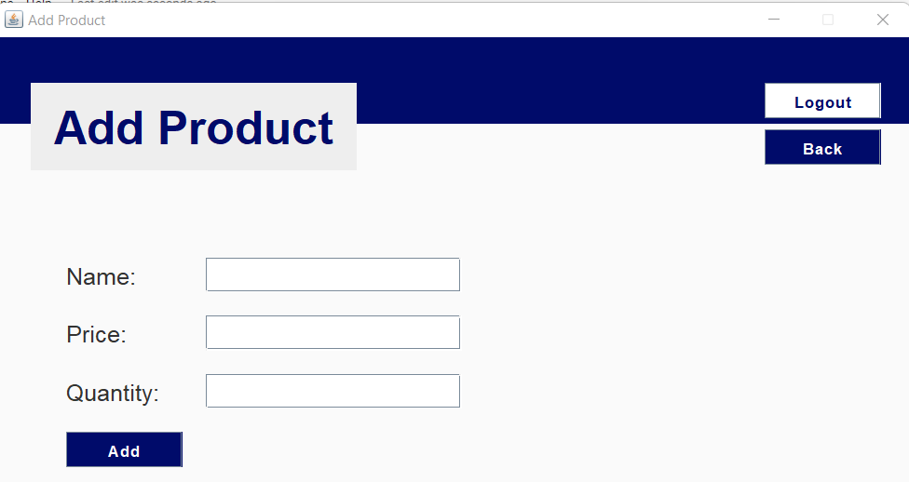
How it looks cont.

Slide 14
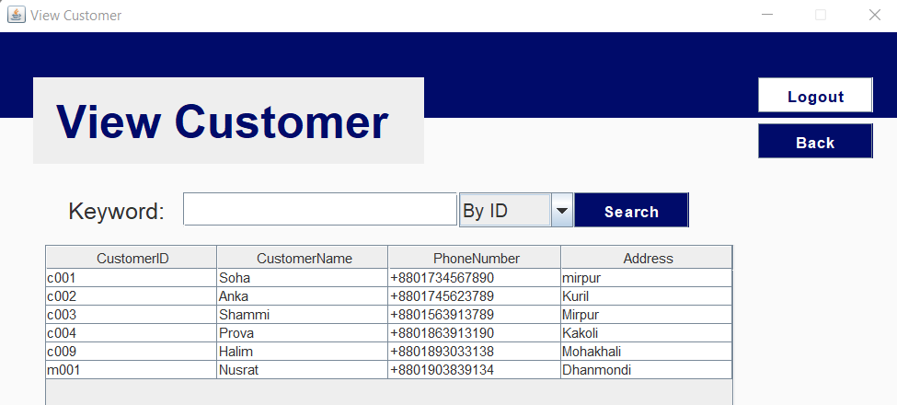
How it looks cont.

Slide 15
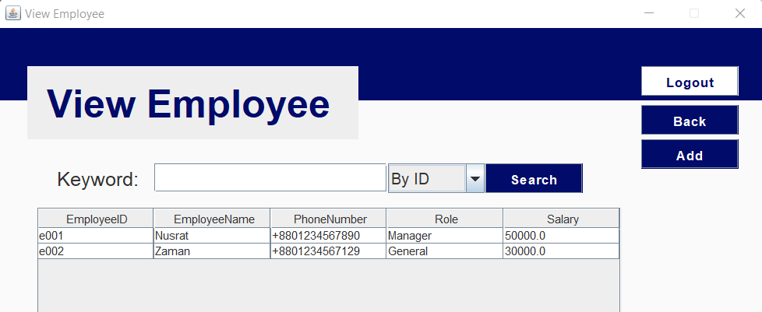
How it looks cont.

Slide 16
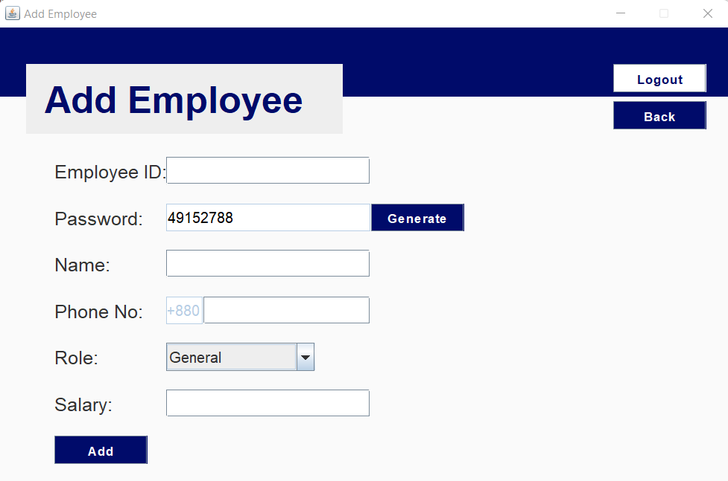
How it looks cont.

Slide 17
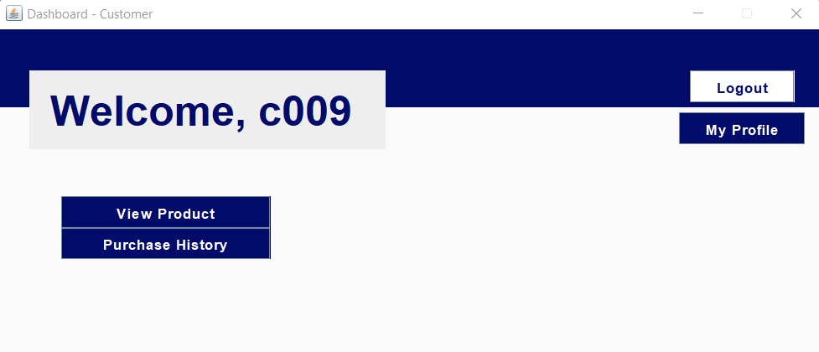
How it looks cont.

Slide 18
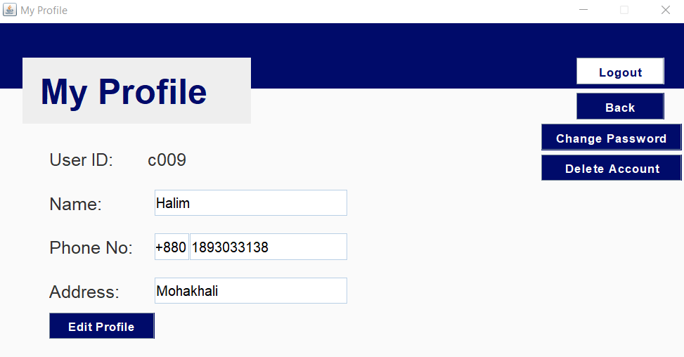
How it looks cont.

Slide 19
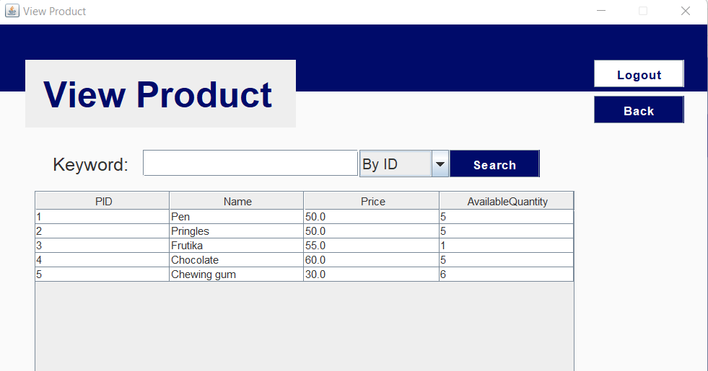
How it looks cont.

Slide 20
Future Works
Web based system so that each type of user can access from anywhere.

Slide 21
Conclusion
Shop Management System is a very necessary system for shop owners and employee. We tried to make such a system that helps people to find an easy way to use it.

Slide 22
Reference
https://www.softwaresuggest.com/blog/best-store-management-software/#
https://www.slideshare.net/TanjarulIslamMishu/shop-management-system-80146639

Slide 23
Thank You!

